Slide 1
Molar conductivity of strong electrolytes
M.A. Ibraheem

Slide 2
Introduction
Materials are considered as strong electrolytes if it highly dissociated and give very conducting aqueous solutions. The high conductivity of such solutions is as results of easy dissociation inside the water to its ions, therefore the molar conductivity of such is also high. These type of electrolytes are completely ionized at all dilutions but when farther dilution is proceeded the conductivity will reach to point where beyond that any farther dilutions will not increase the molar conductivity. At that point the maximum molar conductivity can be achieved which is denoted as $Λ_{o}$
$Λ_{o}$ is calculated from Kohlrausch equation as below
Where
$Λ_{m}=Λ_{o}−K\sqrt{c} ………………………..\left(1\right)$
https://www.coursehero.com/file/13442344/PDF-Electrochemistry-I/

Slide 3
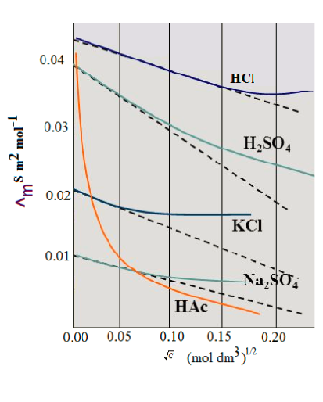
When the molar conductivity is plotted against the square root of the concentration we will get a straight strike or line with a negative slope
The intercept after extending the curve will give us the value of highes value of molar conductivity or $Λ_{o}$ as it shown in the figure

Slide 4
Procedure
Prepare three solutions of (0.1M) of NaCl, KCl and NaNO₃ in 25 ml volumetric flask
2. Prepare four diluted solutions of 250 ml of each as it listed in the below table ,from the solutions prepared in step 1.
3. Measure the conductivity of each solutions and calculated the specific conductivity ( constant cell is 0.1 cm⁻¹) and molar conductivity as it illustrates in the table 2 bellow
KCl | NaCl | NaNO₃
1X10⁻⁴M | 1X10⁻⁴M | 1X10⁻⁴M
2X10⁻⁴M | 2X10⁻⁴M | 2X10⁻⁴M
4X10⁻⁴M | 4X10⁻⁴M | 4X10⁻⁴M
8X10⁻⁴M | 8X10⁻⁴M | 8X10⁻⁴M
Table No 1 shows list of the concentrations of of NaCl, KCl and NaNO₃

Slide 5
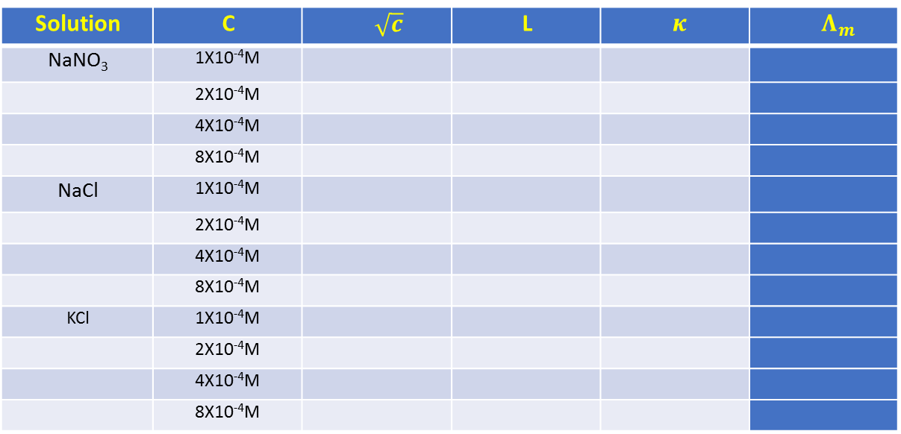
Procedure
$$Λ_{m}$$ | $$κ$$ | L | $$\sqrt{c}$$ | C | Solution
 |  |  |  | 1X10⁻⁴M | NaNO₃
 |  |  |  | 2X10⁻⁴M
 |  |  |  | 4X10⁻⁴M
 |  |  |  | 8X10⁻⁴M
 |  |  |  | 1X10⁻⁴M | NaCl
 |  |  |  | 2X10⁻⁴M
 |  |  |  | 4X10⁻⁴M
 |  |  |  | 8X10⁻⁴M
 |  |  |  | 1X10⁻⁴M | KCl
 |  |  |  | 2X10⁻⁴M
 |  |  |  | 4X10⁻⁴M
 |  |  |  | 8X10⁻⁴M
Plote the Molar conductivity$Λ_{m}$ against the $\sqrt{c}$ , then extend the straight part of the curve to the y axis and obtain the value of $Λ_{o}$, to get accurate results use excel to draw the curve and intercept function.

